Slide 1
AIM
Static code
analysis
TEEX

Slide 2
“All code is guilty, until proven innocent.”
Anonymous

Slide 3
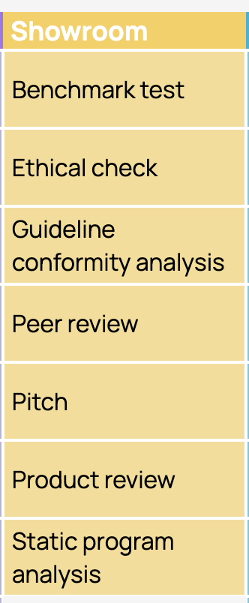
Static Analysis
Static analysis or also known as Static Code Analysis is a process to analyze the source code of a software without running the software itself. Static Analysis are generally used by developers as part of the development and component testing process.
In the ICT Research Methods Pack this method is known as “Static program analysis” and is part of the Showroom research area.

Slide 4
Benefits...
Detecting the possible bugs on your code (crash, memory leak, stack overflow, buffer overflow, etc),
Find any vulnerabilities in the corner of your applications (clumsy developer miss),
Finding possible wrong logic and any bad practice on your project,
Finding areas of the code that may need more testing or deeper review,

Slide 5
Benefits… (cont)
Finding duplicate code which is could be moved into another methods to reduce code complexity,
Identifying design issues such as Cyclomatic Complexity and helping reduce the code complexity improve maintainability,
Identifying potential software quality issues before the code moves to production.

Slide 6
CyClomatic complexity
“The cyclomatic complexity of a code section is the quantitative measure of the number of linearly independent paths in it. It is a software metric used to indicate the complexity of a program. It is computed using the Control Flow Graph of the program. The nodes in the graph indicate the smallest group of commands of a program, and a directed edge in it connects the two nodes i.e. if the second command might immediately follow the first command.”

Slide 7
CyClomatic complexity for a single function
CC = E – N + 2
where
E = the number of edges in the control flow graph
N = the number of nodes in the control flow graph
P = the number of connected components

Slide 8
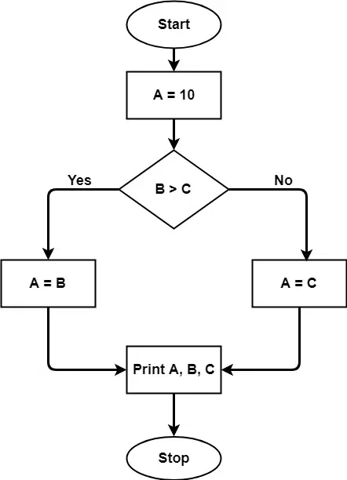
CyClomatic complexity
The graph shows seven shapes(nodes), and seven lines(edges), hence cyclomatic complexity is 7-7+2 = 2.
A = 10 IF B > C THEN A = B ELSE A = C ENDIF Print A Print B Print C

Slide 9

SonarQube

Slide 10
SonarQube – What is it?
SonarQube is an open source Web Application
Takes in input a set of source code files and a set of analyses results (produced by external tools).
Stores both sources and results in a database.
Makes available the gathered information via a dynamic website where the results are shown in the context of the code itself.

Slide 11
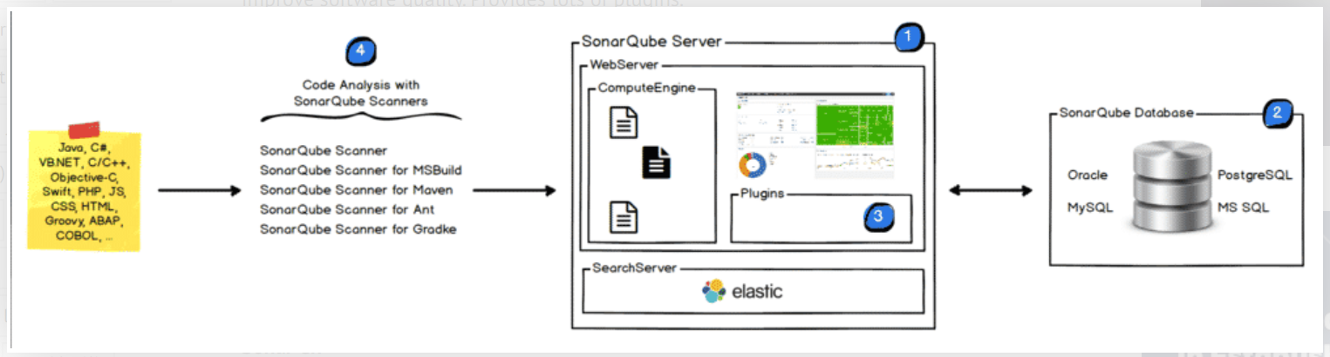
Architecture...
img src: http://tech.gaeatimes.com

Slide 12
Type of analysis
Static analysis of source code → Lots of languages supported (Java files, JavaScript, TypeScript, etc.)
Static analysis of compiled code → Certain languages supported (.class files in Java, .dll files in C#, etc.)
Dynamic analysis of code → Certain languages supported (execution of unit tests in Java, C#, JavaScript, TypeScript. etc.)
Note: Analysis is carried out using pre-defined rules based on industry coding standards /best practices. Rules for a particular language are available as plug-in for most of the languages.

Slide 13
Quality Profile
Each language plugin comes with a predefined, built-in profile (called “Sonar way”) having set of pre-defined rules and it will be used as default profile during analysis for projects.
New quality profiles can be created to configure rules as per project requirements, but it’s optional.
SonarQube allows inheritance in quality profiles thereby allowing to inherit rules provided by plugin in the default profile.

